Slide 1

Transformers
Grigory Sapunov
CTO / Intento
HSE / #12 / 17.12.2019

Slide 2
Self-Attention Neural Networks (SAN):
Transformer Architecture

Slide 3
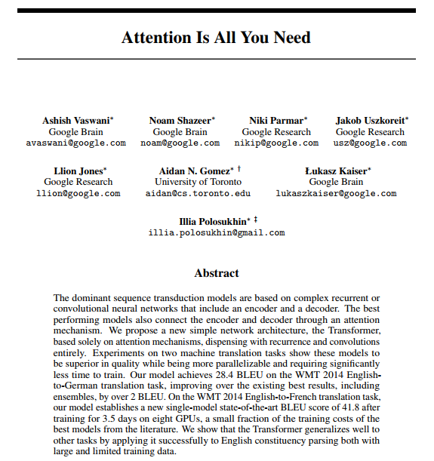
Attention Is All You Need, https://arxiv.org/abs/1706.03762

Slide 4
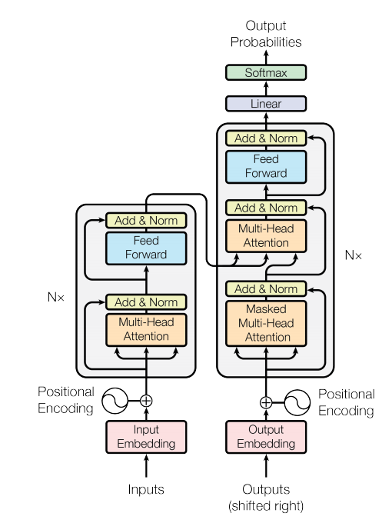
Transformer
A new simple network architecture, the Transformer:
Is a Encoder-Decoder architecture
Based solely on attention mechanisms (no RNN/CNN)
The major component in the transformer is the unit of multi-head self-attention mechanism.
Fast: only matrix multiplications
Strong results on standard WMT datasets

Slide 5

Working pipeline
http://jalammar.github.io/illustrated-transformer/

Slide 6
Inputs
The initial inputs to the encoder are the embeddings of the input sequence, and the initial inputs to the decoder are the embeddings of the outputs up to that point.

Slide 7
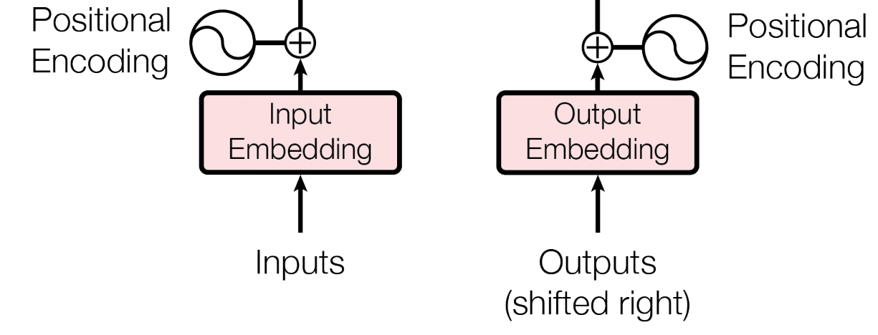
Embeddings
Similarly to other sequence transduction models, we use learned embeddings to convert the input tokens and output tokens to vectors of dimension d_{model}. We share the same weight matrix between the two embedding layers.

Slide 8
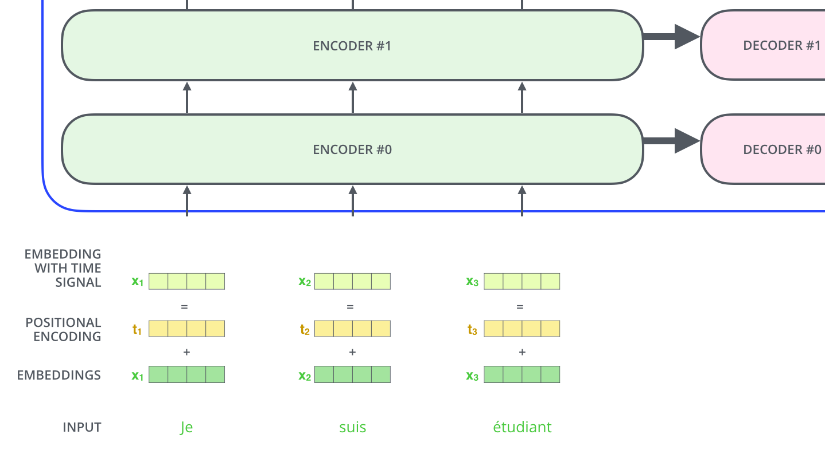
Embeddings
http://jalammar.github.io/illustrated-transformer/

Slide 9
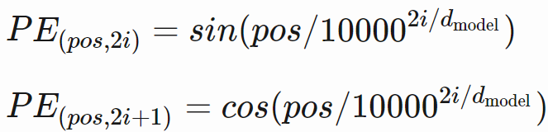
Positional Encoding
Since our model contains no recurrence and no convolution, in order for the model to make use of the order of the sequence, we must inject some information about the relative or absolute position of the tokens in the sequence. To this end, we add “positional encodings” to the input embeddings at the bottoms of the encoder and decoder stacks. The positional encodings have the same dimension d_{model} as the embeddings, so that the two can be summed.
In this work, we use sine and cosine functions of different frequencies:
where pos is the position and i is the dimension.

Slide 10
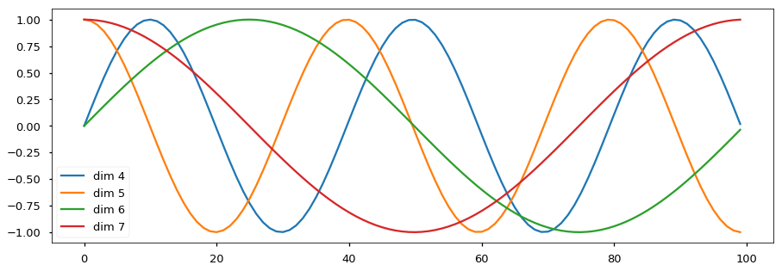
Positional Encoding
That is, each dimension of the positional encoding corresponds to a sinusoid. The wavelengths form a geometric progression from 2π to 10000⋅2π.
Below the positional encoding will add in a sine wave based on position. The frequency and offset of the wave is different for each dimension.

Slide 11

Positional Encoding
d=128, len=50
https://kazemnejad.com/blog/transformer_architecture_positional_encoding/

Slide 12
Positional Encoding
Sinusoidal Position Encoding (Vaswani et al, 2017, https://arxiv.org/abs/1706.03762) Use sine/cosine waves as previously described.
Learned Position Encoding (Gehring et al, 2017, https://arxiv.org/abs/1705.03122) Embed the absolute position of input elements. Can’t extrapolate to lengths it has never seen during training.
Relative Position Representations [currently work the best] (Shaw et al, 2018, https://arxiv.org/abs/1803.02155) Model the input as a labeled, directed, fully-connected graph. Learn edge representation.

Slide 13

https://lilianweng.github.io/lil-log/2018/06/24/attention-attention.html

Slide 14
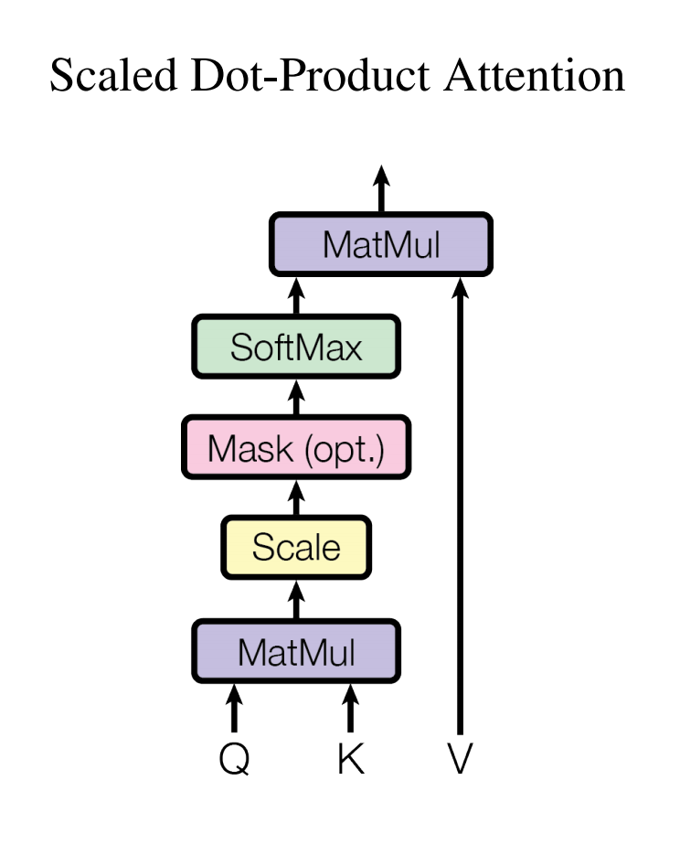
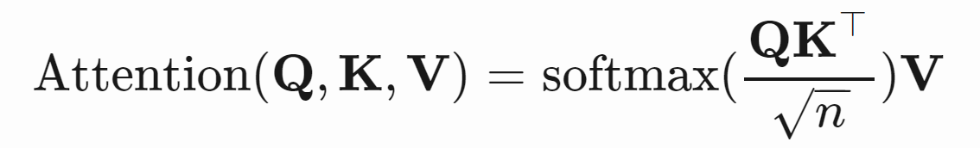
Scaled dot-product attention
The transformer adopts the scaled dot-product attention: the output is a weighted sum of the values, where the weight assigned to each value is determined by the dot-product of the query with all the keys:
The input consists of queries and keys of dimension d_{k}, and values of dimension d_{v}.

Slide 15

Scaled dot-product attention
http://jalammar.github.io/illustrated-transformer/

Slide 16

Scaled dot-product attention
http://jalammar.github.io/illustrated-transformer/

Slide 17
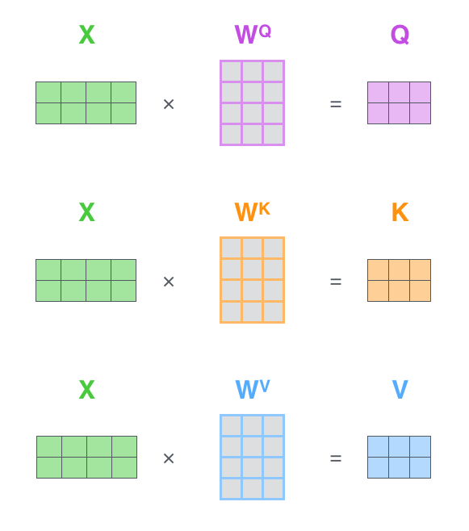
Scaled dot-product attention: Matrix formulation
http://jalammar.github.io/illustrated-transformer/

Slide 18

Scaled dot-product attention: Matrix formulation
http://jalammar.github.io/illustrated-transformer/

Slide 19

Self-attention example
http://jalammar.github.io/illustrated-transformer/

Slide 20
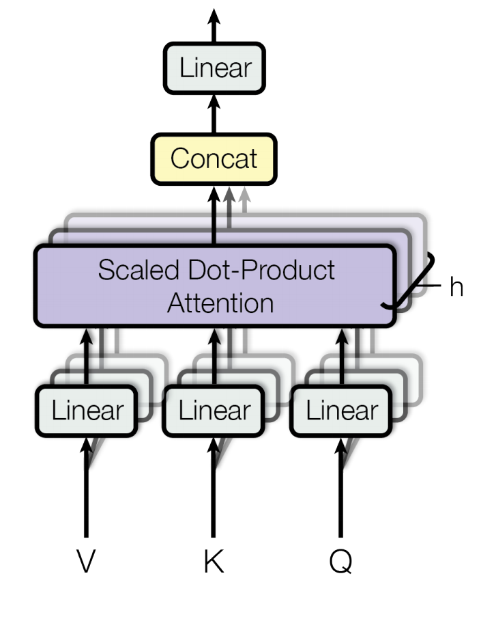
Multi-head self-attention mechanism
Rather than only computing the attention once, the multi-head mechanism runs through the scaled dot-product attention multiple times in parallel. The independent attention outputs are simply concatenated and linearly transformed into the expected dimensions.
According to the paper, “multi-head attention allows the model to jointly attend to information from different representation subspaces at different positions. With a single attention head, averaging inhibits this.”

Slide 21
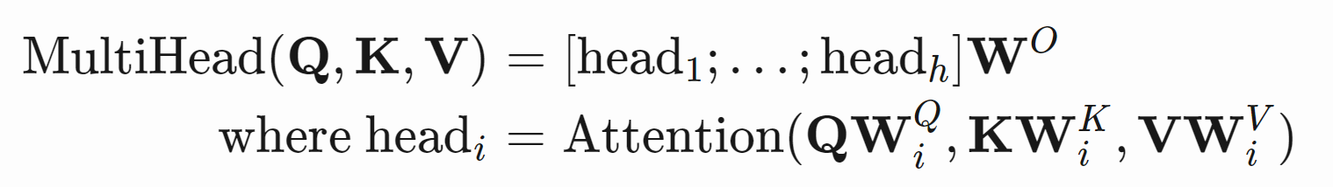
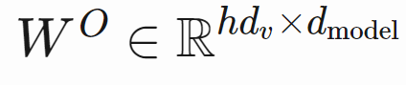
Multi-head self-attention mechanism
In this work we employ h=8 parallel attention layers, or heads. For each of these we use d_{k}=d_{v}=d_{model}/h=64.
Due to the reduced dimension of each head, the total computational cost is similar to that of single-head attention with full dimensionality.

Slide 22
Multi-head self-attention mechanism
Essentially, the Multi-Head Attention is just several attention layers stacked together with different linear transformations of the same input.

Slide 23
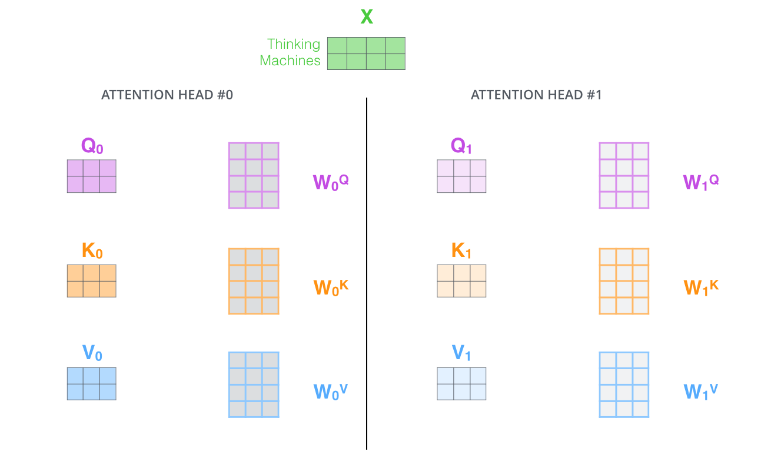
Multi-head self-attention mechanism
http://jalammar.github.io/illustrated-transformer/

Slide 24
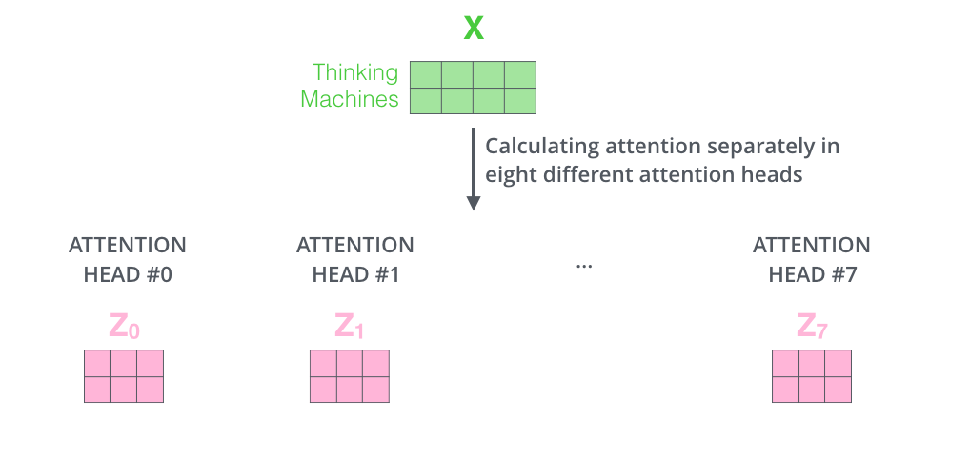
Multi-head self-attention mechanism
http://jalammar.github.io/illustrated-transformer/

Slide 25
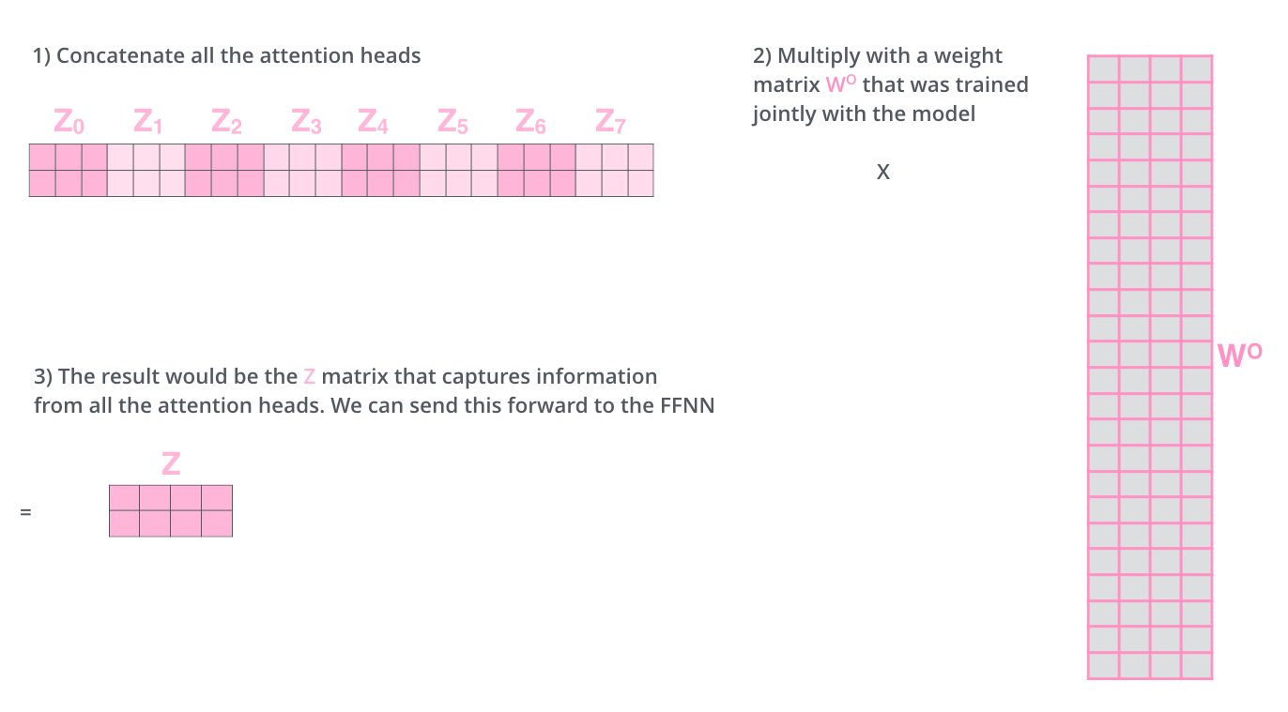
Multi-head self-attention mechanism
http://jalammar.github.io/illustrated-transformer/

Slide 26

Multi-head self-attention mechanism
http://jalammar.github.io/illustrated-transformer/

Slide 27
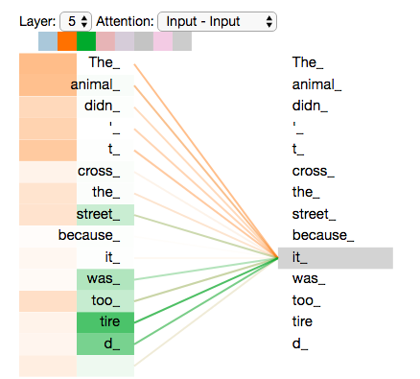
Multi-head self-attention example (2 heads shown)
http://jalammar.github.io/illustrated-transformer/

Slide 28
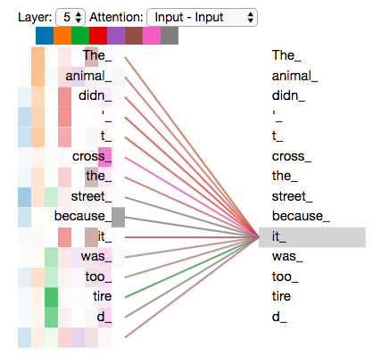
Multi-head self-attention example (8 heads shown)
http://jalammar.github.io/illustrated-transformer/

Slide 29
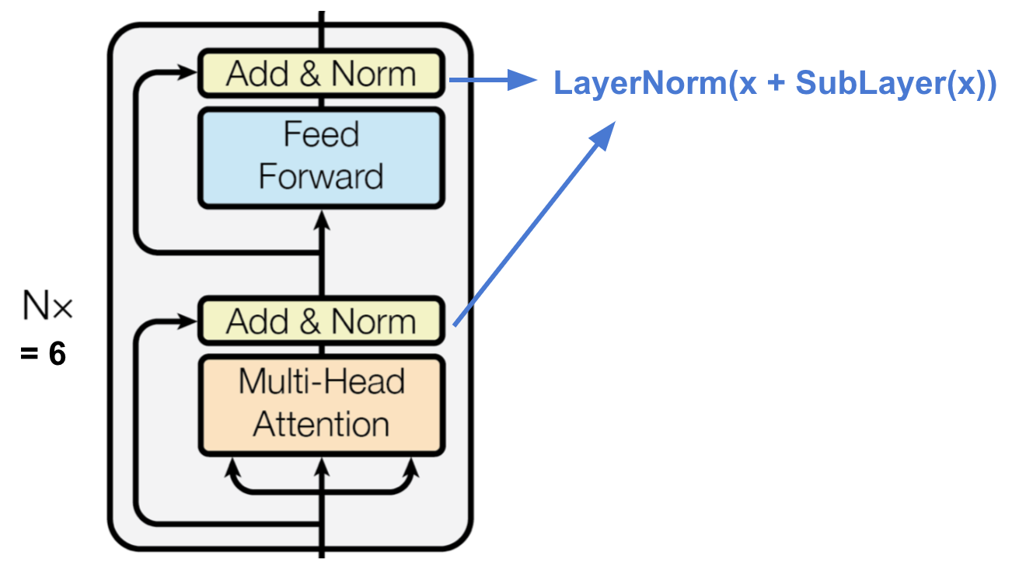
Encoder
The encoder is composed of a stack of N=6 identical layers.
Each layer has two sub-layers. The first is a multi-head self-attention mechanism, and the second is a simple, position-wise fully connected feed-forward network.
To facilitate residual connections, all sub-layers in the model, as well as the embedding layers, produce outputs of dimension d_{model}=512.

Slide 30
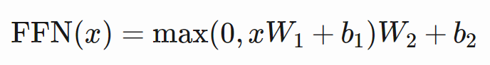
Position-wise Feed-Forward Networks
Each of the layers in our encoder and decoder contains a fully connected feed-forward network, which is applied to each position separately and identically. This consists of two linear transformations with a ReLU activation in between.
The dimensionality of input and output is d_{model}=512, and the inner-layer has dimensionality d_{ff}=2048.

Slide 31
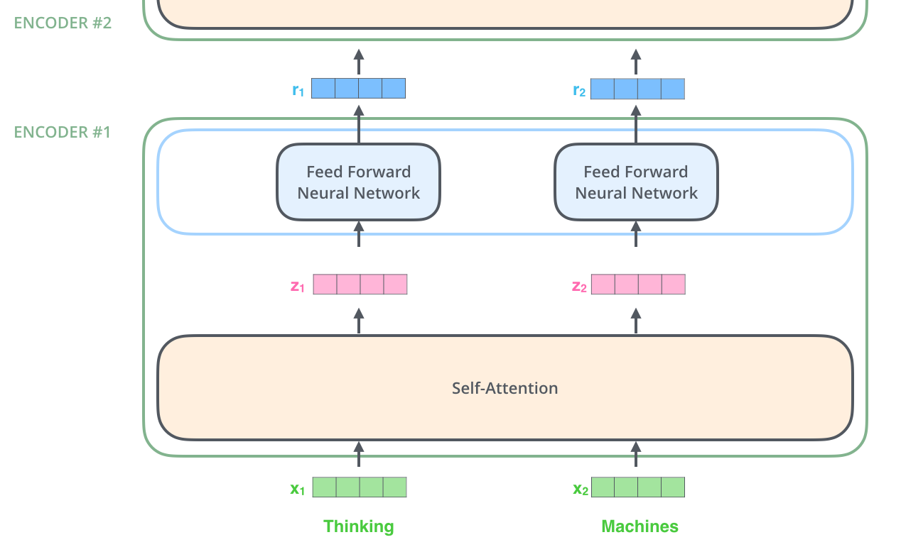
Encoder
http://jalammar.github.io/illustrated-transformer/

Slide 32

Encoder
http://jalammar.github.io/illustrated-transformer/

Slide 33
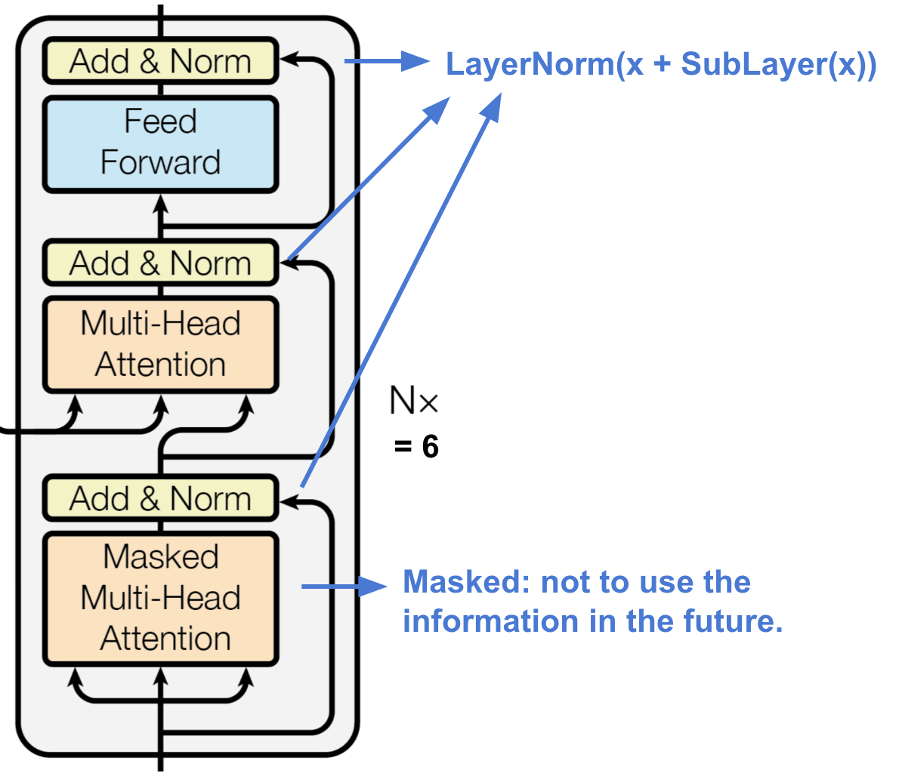
Decoder
The decoder is also composed of a stack of N=6 identical layers.
In addition to the two sub-layers in each encoder layer, the decoder inserts a third sub-layer, which performs multi-head attention over the output of the encoder stack.
The Multi-Head Attention layer works just like multiheaded self-attention, except it creates its Queries matrix from the layer below it, and takes the Keys and Values matrix from the output of the encoder stack.

Slide 34
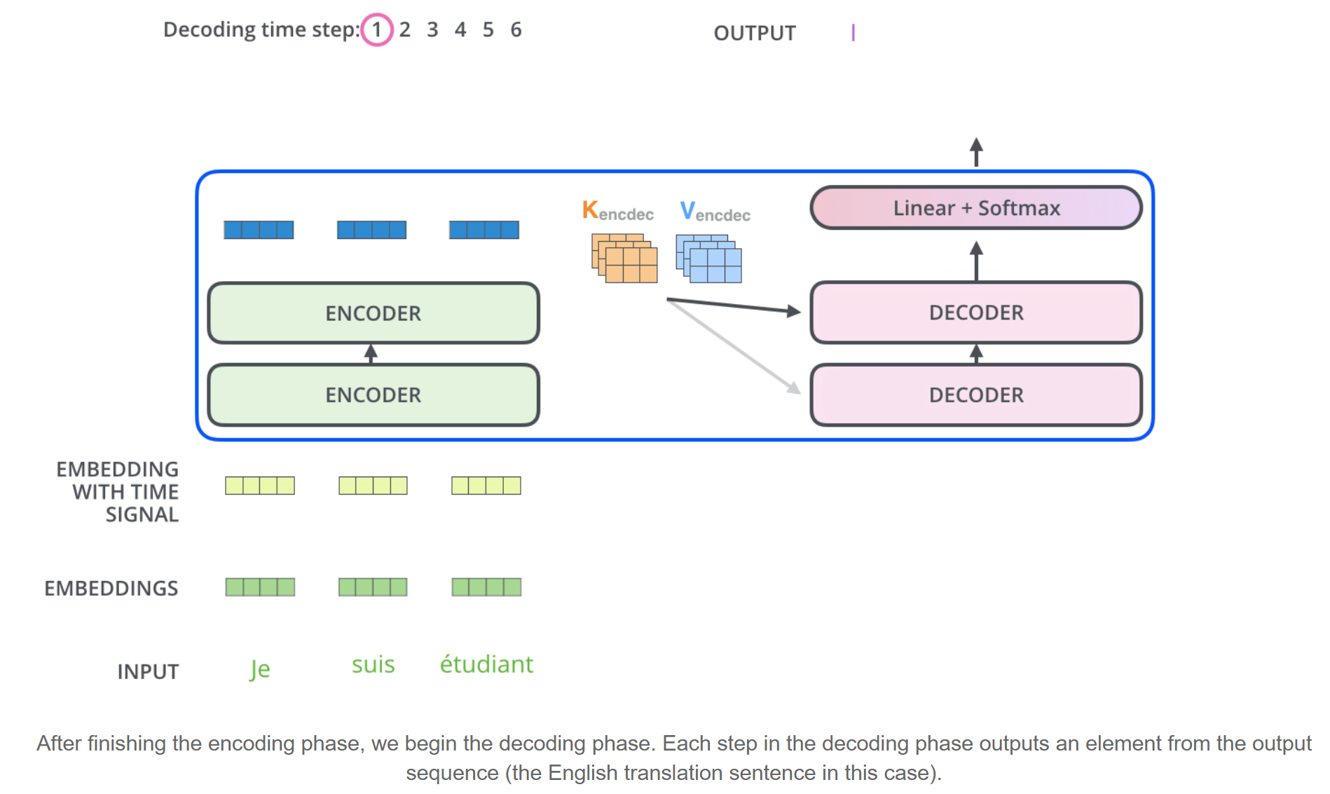
Decoder
http://jalammar.github.io/illustrated-transformer/

Slide 35
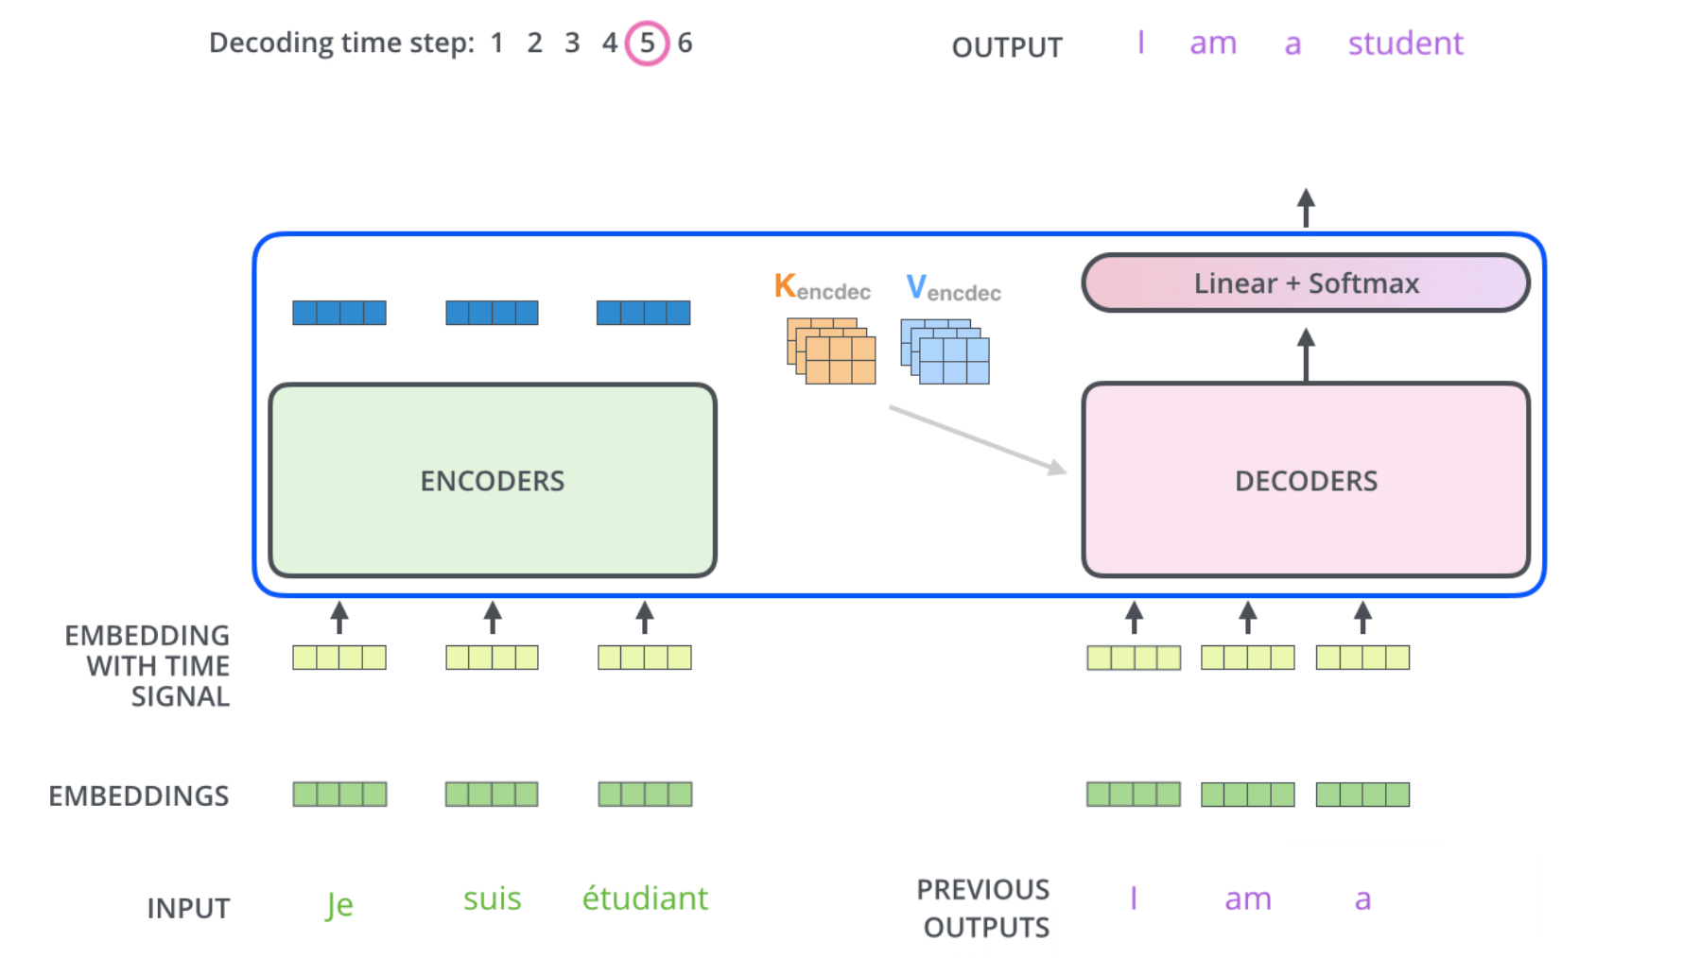
Decoder
http://jalammar.github.io/illustrated-transformer/

Slide 36
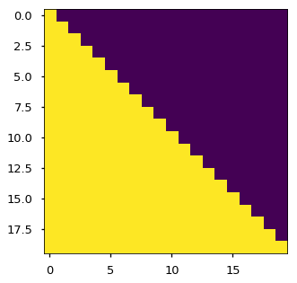
Masking in Decoder
We also modify the self-attention sub-layer in the decoder stack to prevent positions from attending to subsequent positions.
In the decoder, the self-attention layer is only allowed to attend to earlier positions in the output sequence. This is done by masking future positions (setting them to -inf) before the softmax step in the self-attention calculation.
The attention mask shows the position each tgt word (row) is allowed to look at (column). Words are blocked for attending to future words during training.

Slide 37

Working pipeline
http://jalammar.github.io/illustrated-transformer/

Slide 38
Attention in the model
In “encoder-decoder attention” layers, the queries come from the previous decoder layer, and the memory keys and values come from the output of the encoder. This allows every position in the decoder to attend over all positions in the input sequence. This mimics the typical encoder-decoder attention mechanisms in sequence-to-sequence models.
The encoder contains self-attention layers. In a self-attention layer all of the keys, values and queries come from the same place, in this case, the output of the previous layer in the encoder. Each position in the encoder can attend to all positions in the previous layer of the encoder.
Similarly, self-attention layers in the decoder allow each position in the decoder to attend to all positions in the decoder up to and including that position. We need to prevent leftward information flow in the decoder to preserve the auto-regressive property (by masking out all values in the input of the softmax which correspond to illegal connections).

Slide 39
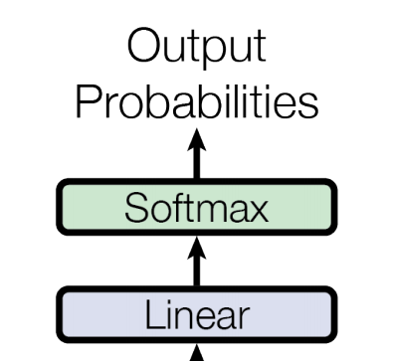
The Final Linear and Softmax Layer
We use the usual learned linear transformation and softmax function to convert the decoder output to predicted next-token probabilities.

Slide 40
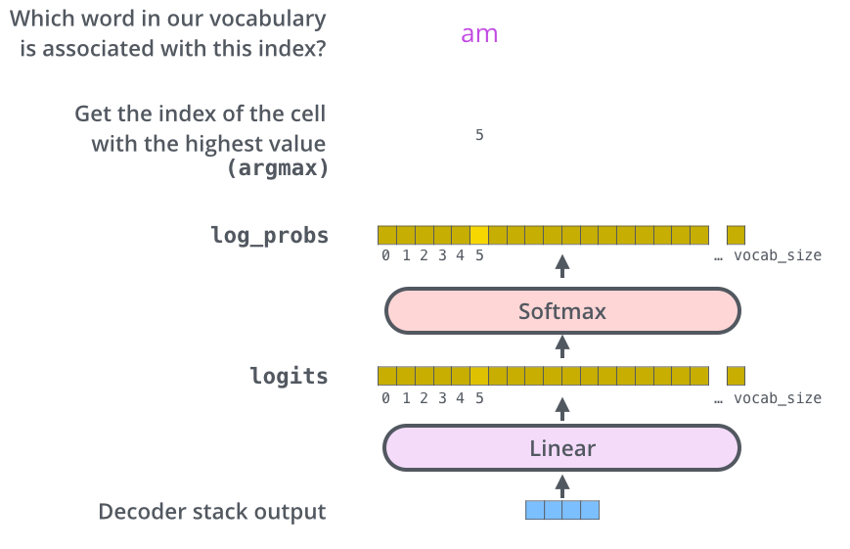
The Final Linear and Softmax Layer
http://jalammar.github.io/illustrated-transformer/

Slide 41
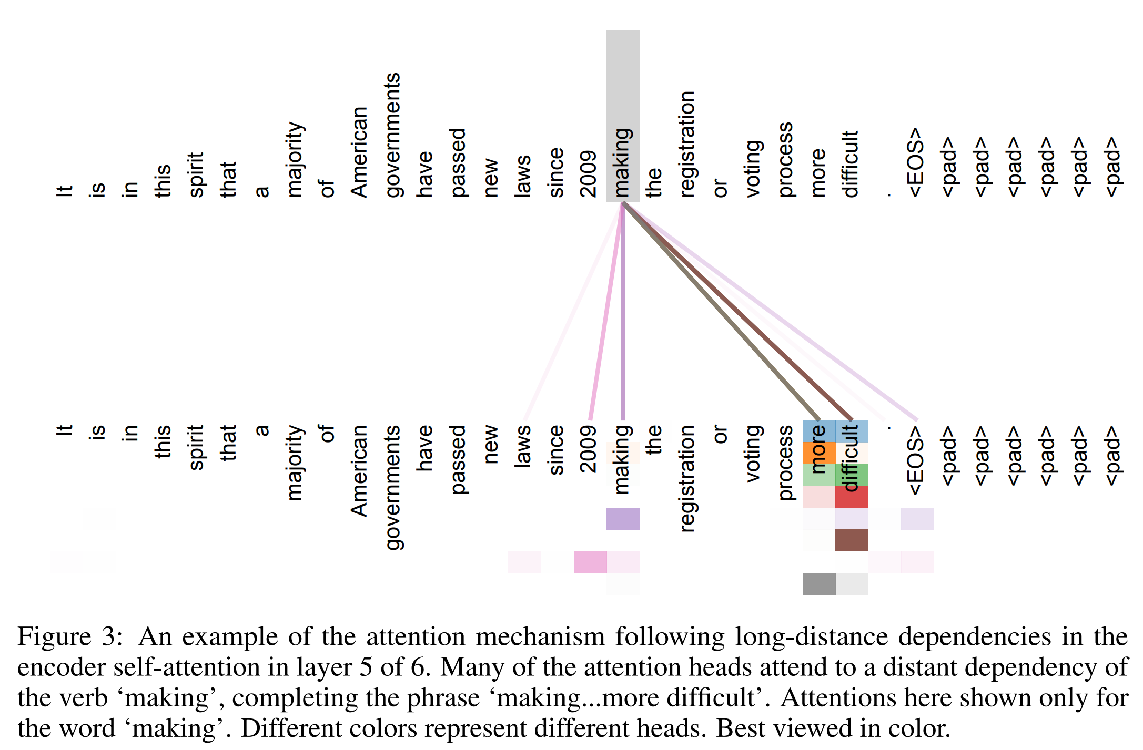
Attention visualization

Slide 42

Applying the Transformer to machine translation
https://ai.googleblog.com/2017/08/transformer-novel-neural-network.html

Slide 43
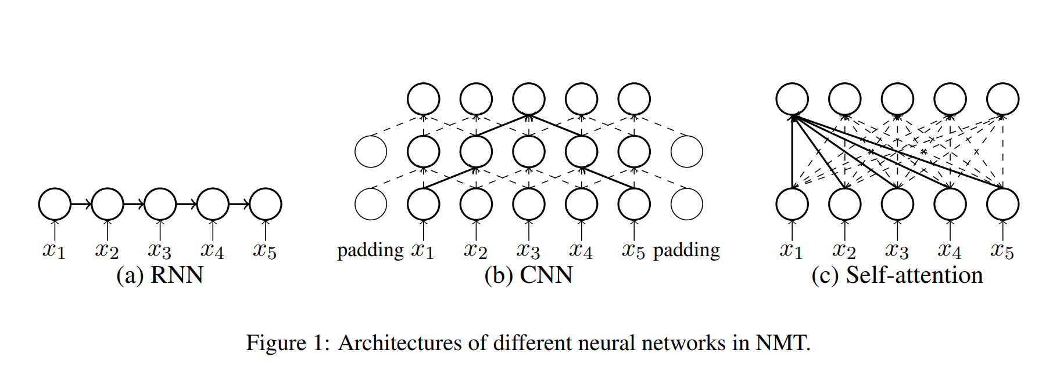
Different architectures for NMT
Why Self-Attention? A Targeted Evaluation of Neural Machine Translation Architectures, https://arxiv.org/abs/1808.08946

Slide 44
Resources
The Annotated Transformer http://nlp.seas.harvard.edu/2018/04/03/attention.html
Attention? Attention! https://lilianweng.github.io/lil-log/2018/06/24/attention-attention.html
The Illustrated Transformer http://jalammar.github.io/illustrated-transformer/
Paper Dissected: “Attention is All You Need” Explained http://mlexplained.com/2017/12/29/attention-is-all-you-need-explained/
The Transformer – Attention is all you need. https://mchromiak.github.io/articles/2017/Sep/12/Transformer-Attention-is-all-you-need/
When Recurrent Models Don't Need to be Recurrent https://bair.berkeley.edu/blog/2018/08/06/recurrent/
Self-Attention Mechanisms in Natural Language Processing, https://www.alibabacloud.com/blog/self-attention-mechanisms-in-natural-language-processing_593968

Slide 45
Code
https://github.com/huggingface/transformers
https://github.com/ThilinaRajapakse/simpletransformers
https://github.com/pytorch/fairseq
https://www.tensorflow.org/tutorials/text/transformer
https://github.com/tensorflow/models/tree/master/official/transformer
Tensor2Tensor library (the original code)
https://github.com/tensorflow/tensor2tensor
Running the Transformer with Tensor2Tensor https://cloud.google.com/tpu/docs/tutorials/transformer
https://ai.googleblog.com/2017/06/accelerating-deep-learning-research.html

Slide 46
Transformer: The next steps

Slide 47

Другие виды трансформеров
Image Transformer
Music Transformer
Universal Transformer
Transformer-XL
Sparse Transformer
...

Slide 48
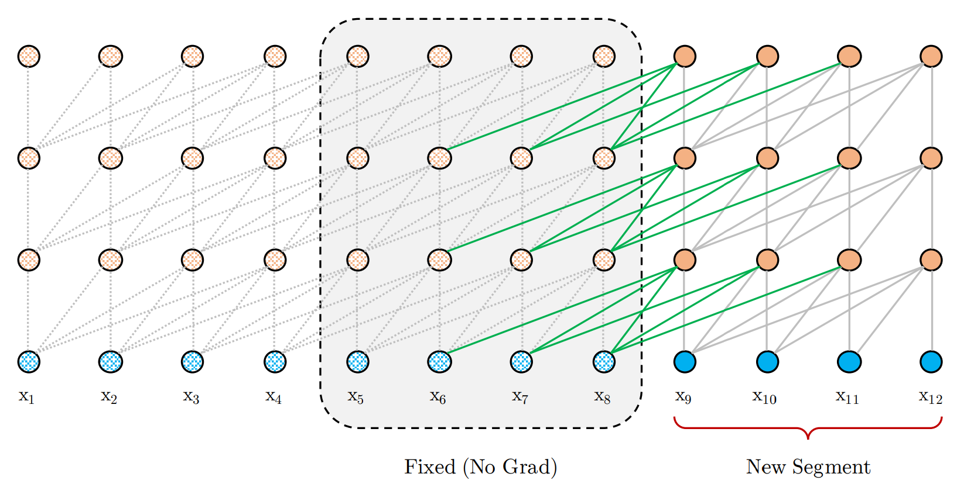
Transformer-XL
Модификация LM на обычном трансформере (декодере). Добавляется возможность посмотреть на репрезентации предыдущего сегмента → можно выучивать более длинные зависимости.
https://arxiv.org/abs/1901.02860

Slide 49
Image Transformer
In this work, we generalize a recently proposed model architecture based on self-attention, the Transformer, to a sequence modeling formulation of image generation with a tractable likelihood. By restricting the self-attention mechanism to attend to local neighborhoods we significantly increase the size of images the model can process in practice, despite maintaining significantly larger receptive fields per layer than typical convolutional neural networks.
Image Transformer, https://arxiv.org/abs/1802.05751

Slide 50
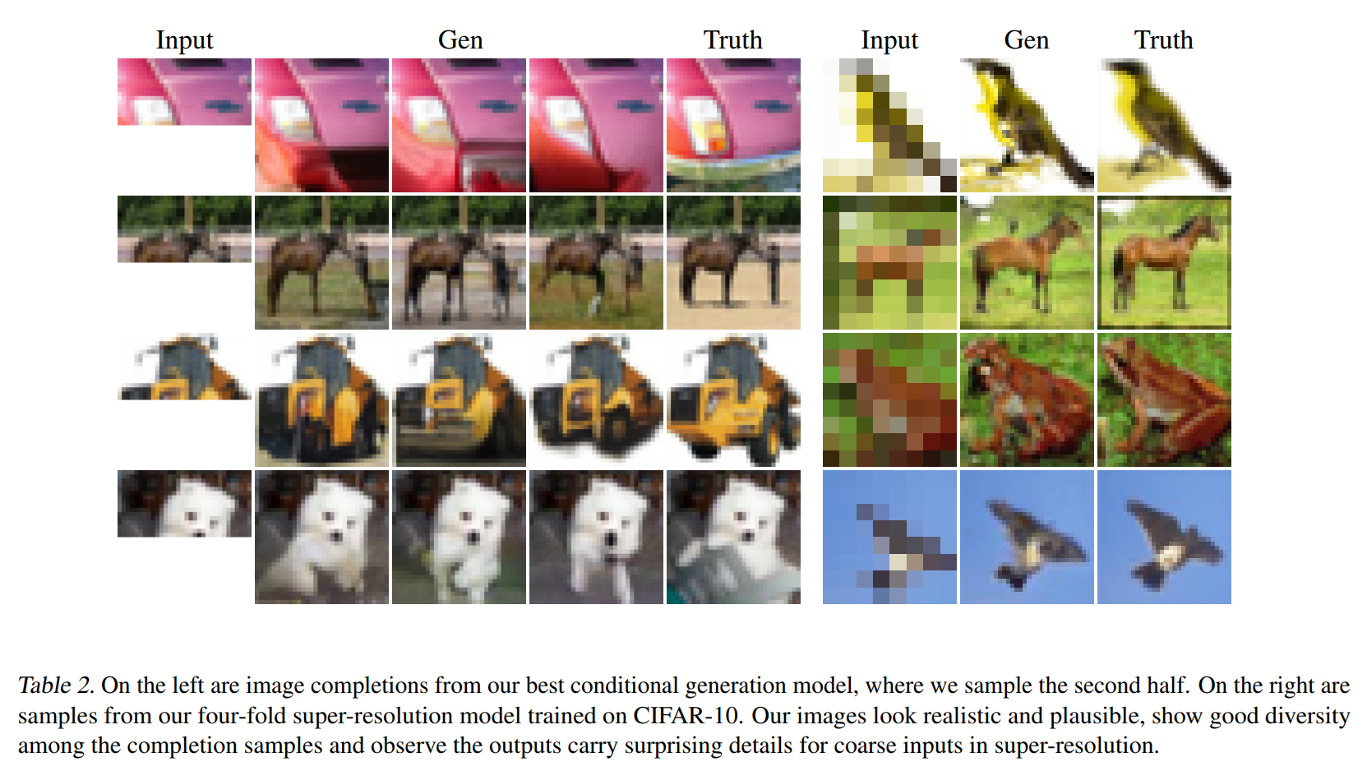
Image Transformer, https://arxiv.org/abs/1802.05751

Slide 51
Universal Transformer
In “Universal Transformers” we extend the standard Transformer to be computationally universal (Turing complete) using a novel, efficient flavor of parallel-in-time recurrence which yields stronger results across a wider range of tasks.
Crucially, where an RNN processes a sequence symbol-by-symbol (left to right), the Universal Transformer processes all symbols at the same time (like the Transformer), but then refines its interpretation of every symbol in parallel over a variable number of recurrent processing steps using self-attention.
This parallel-in-time recurrence mechanism is both faster than the serial recurrence used in RNNs, and also makes the Universal Transformer more powerful than the standard feedforward Transformer.
Moving Beyond Translation with the Universal Transformer
https://ai.googleblog.com/2018/08/moving-beyond-translation-with.html

Slide 52
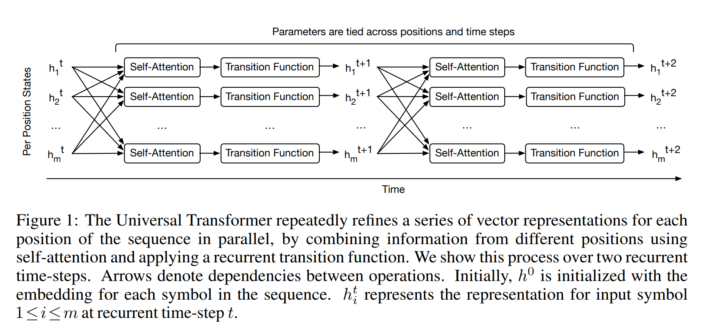
Universal Transformer
Universal Transformers, https://arxiv.org/abs/1807.03819

Slide 53
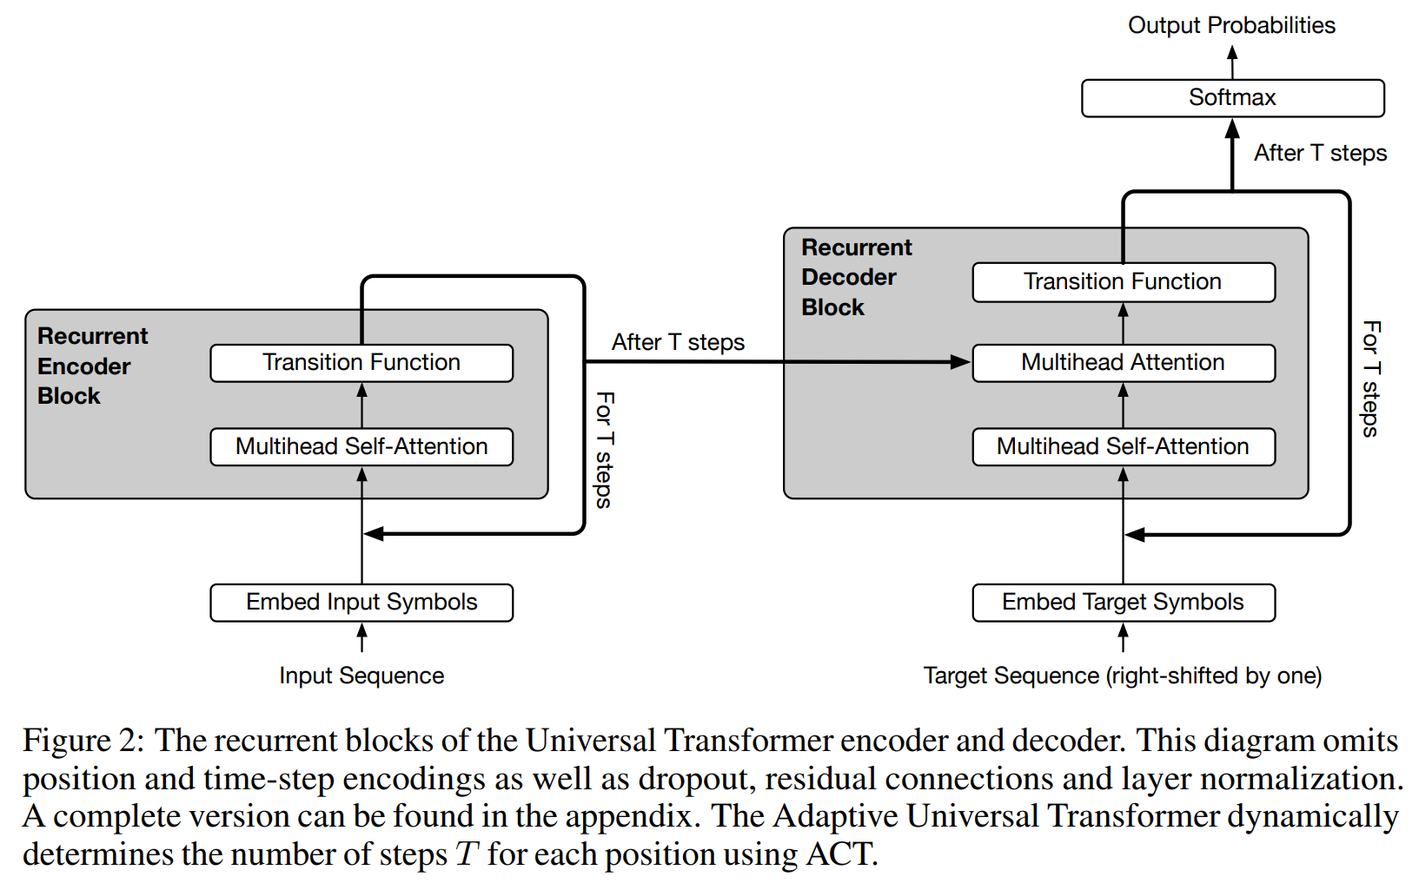
Universal Transformer
Universal Transformers, https://arxiv.org/abs/1807.03819

Slide 54
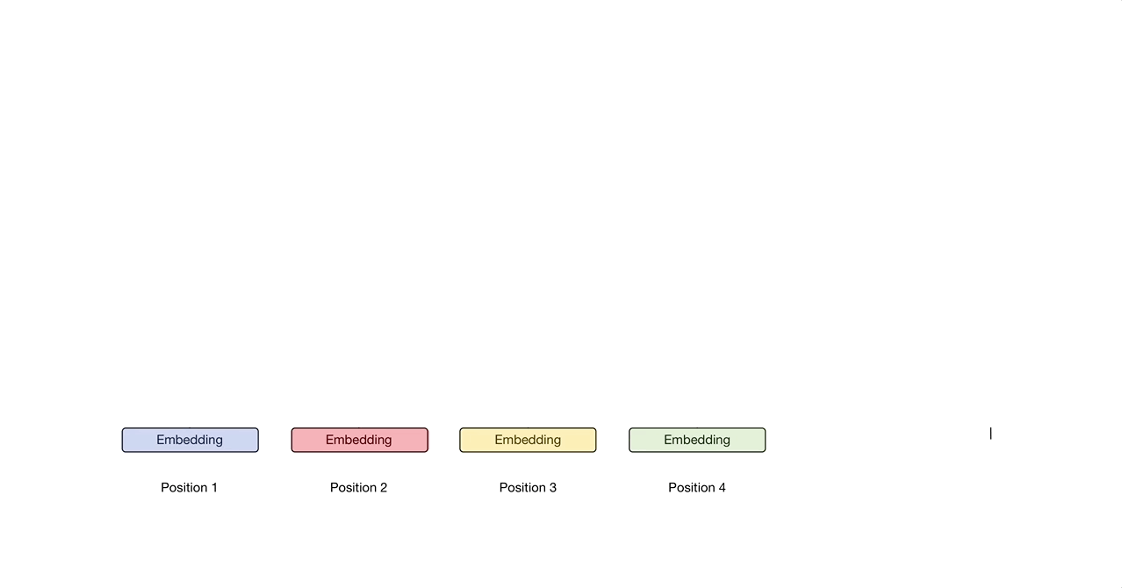
Universal Transformer
https://mostafadehghani.com/2019/05/05/universal-transformers/

Slide 55

BERT & Co

Slide 56
BERT
Bidirectional Encoder Representations from Transformers, or BERT.
BERT is designed to pre-train deep bidirectional representations by jointly conditioning on both left and right context in all layers. As a result, the pre-trained BERT representations can be fine-tuned with just one additional output layer to create state-of-the-art models for a wide range of tasks, such as question answering and language inference, without substantial task-specific architecture modifications.
BERT uses only the encoder part of the Transformer.
Open Sourcing BERT: State-of-the-Art Pre-training for Natural Language Processing, https://ai.googleblog.com/2018/11/open-sourcing-bert-state-of-art-pre.html
Best NLP Model Ever? Google BERT Sets New Standards in 11 Language Tasks
https://medium.com/syncedreview/best-nlp-model-ever-google-bert-sets-new-standards-in-11-language-tasks-4a2a189bc155

Slide 57
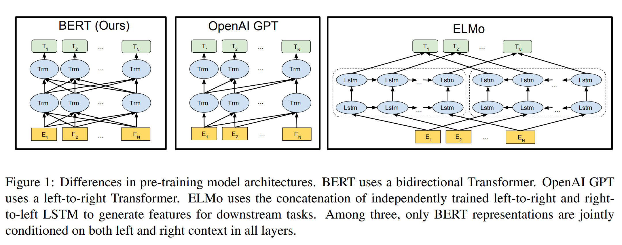
BERT
Bidirectional Encoder Representations from Transformers, or BERT
BERT: Pre-training of Deep Bidirectional Transformers for Language Understanding, https://arxiv.org/abs/1810.04805

Slide 58
BERT
Pre-training tasks:
Masked Language Model: predict random words from within the sequence, not the next word for a sequence of words.
Next Sentence Prediction: give the model two sentences and ask it to predict if the second sentence follows the first in a corpus or not.
Input =
[CLS] the man went to [MASK] store [SEP] he bought a gallon [MASK] milk [SEP]

Slide 59
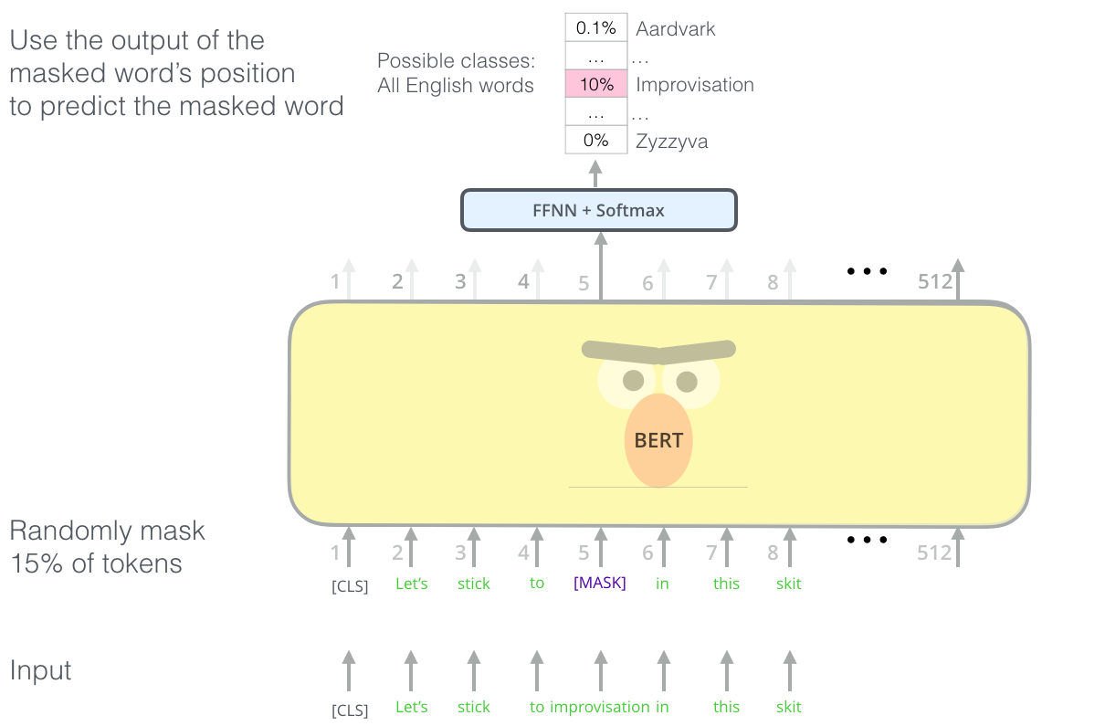
BERT: masked language model
https://jalammar.github.io/illustrated-bert/

Slide 60
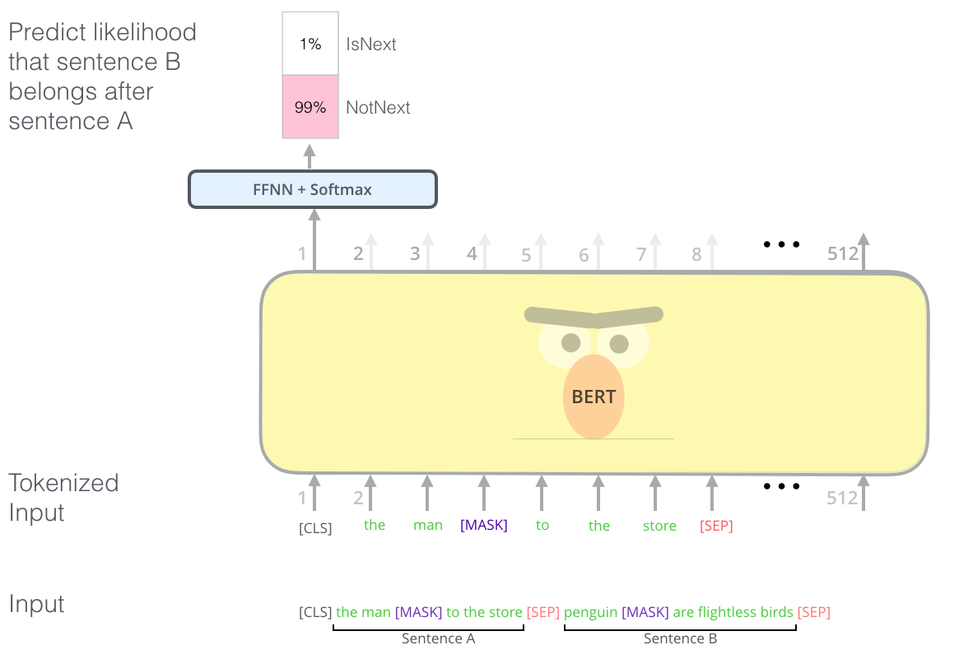
BERT: next sentence prediction
https://jalammar.github.io/illustrated-bert/

Slide 61
BERT
How to use:
Fine-tuning approach: pre-train some model architecture on a LM objective before fine-tuning that same model for a supervised downstream task.
Our task specific models are formed by incorporating BERT with one additional output layer, so a minimal number of parameters need to be learned from scratch.
Feature-based approach: learned representations are typically used as features in a downstream model.
Not all NLP tasks can be easily be represented by a Transformer encoder architecture, and therefore require a task-specific model architecture to be added.
There are major computational benefits to being able to pre-compute an expensive representation of the training data once and then run many experiments with less expensive models on top of this representation

Slide 62
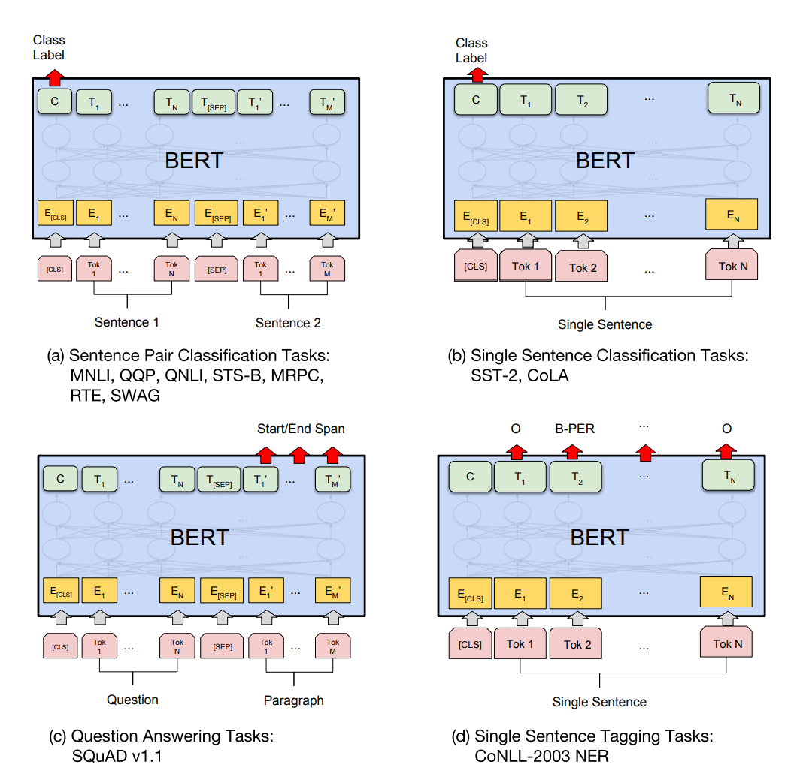
BERT: using fine-tuning approach

Slide 63
BERT: using fine-tuning approach

Slide 64
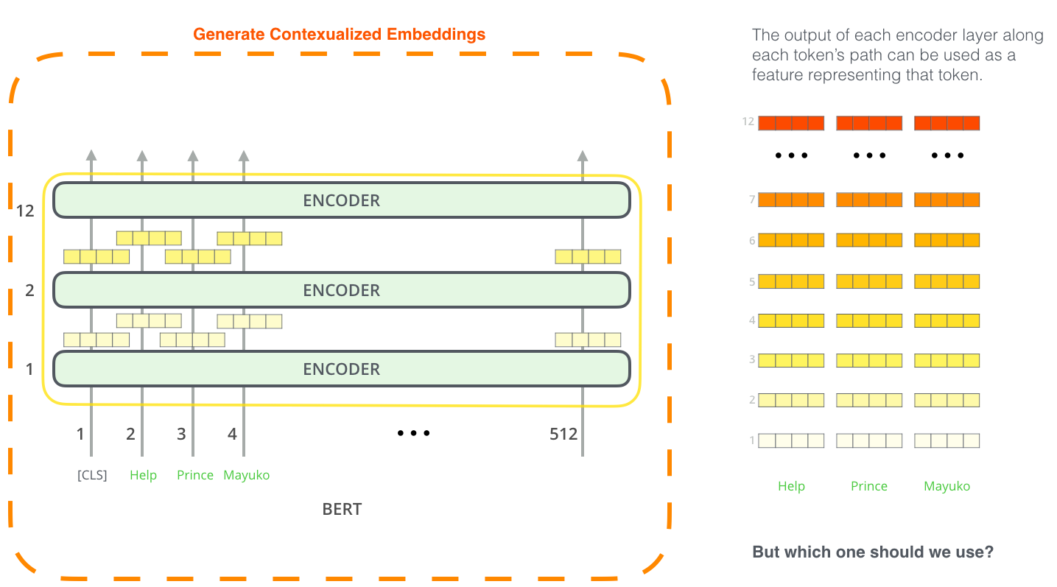
BERT: feature extraction
https://jalammar.github.io/illustrated-bert/

Slide 65
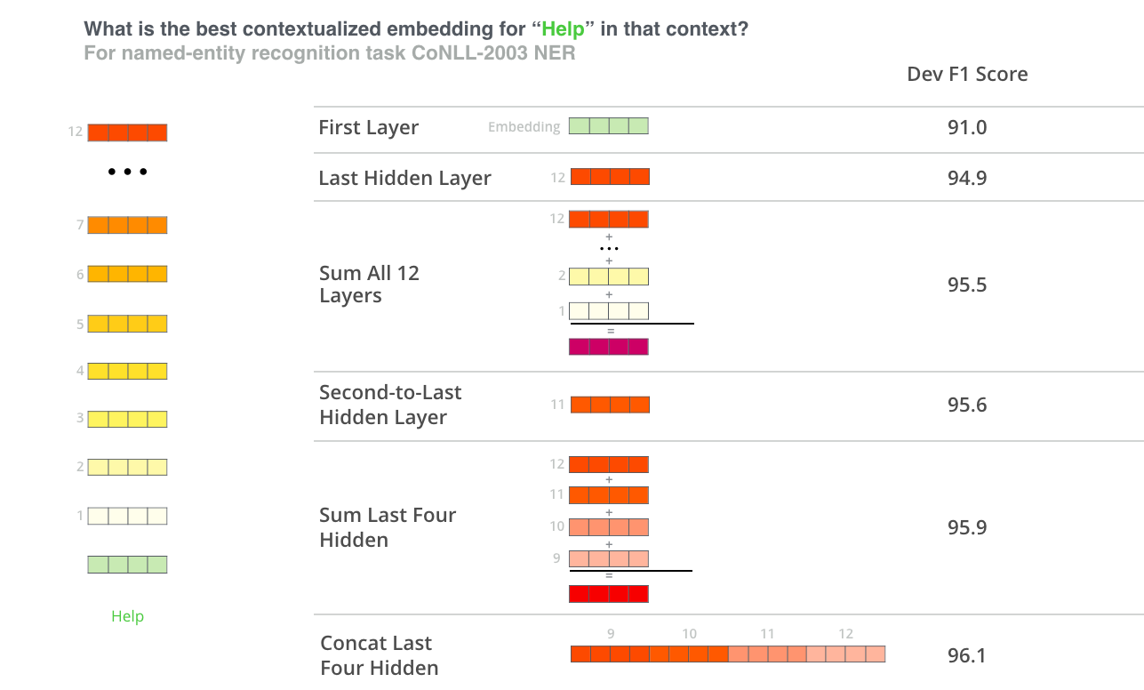
BERT: feature extraction
https://jalammar.github.io/illustrated-bert/

Slide 66
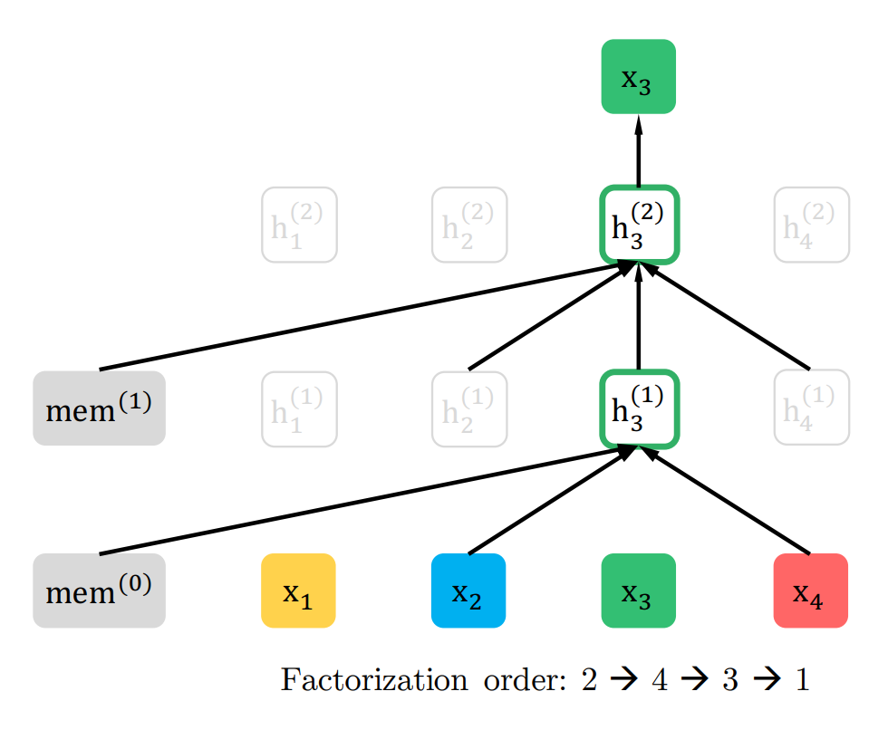
XLNet: Permutation Language Modeling
BERT — это, по сути, denoising autoencoder. Он не учитывает взаимозависимость маскируемых слов.
Традиционные LM не видят правый контекст.
Как устранить проблемы этих методов?
Берём в качестве левого контекста различные перестановки слов во всём предложении.
XLNet = Transformer-XL + PLM
XLNet: Generalized Autoregressive Pretraining for Language Understanding
https://arxiv.org/abs/1906.08237

Slide 67
RoBERTa: A Robustly Optimized BERT
BERT был “недотюнен”.
Улучшения:
Взять больше данных, тренировать дольше
Next sentence prediction лишний
Более длинные предложения
Большие батчи
Динамическое маскирование
Результат: state-of-the-art на 4 из 9 задачах в GLUE.
https://arxiv.org/abs/1907.11692
https://blog.inten.to/papers-roberta-a-robustly-optimized-bert-pretraining-approach-7449bc5423e7

Slide 68
GPT-2
Языковая модель на декодере трансформера.
Умеет генерить продолжение текста. Настолько хорошо, что OpenAI отказался её публиковать и устроил мощный PR.
Публикует понемногу, начиная с маленьких моделей.
Разные языковые модели на трансформерах можно попробовать здесь: https://transformer.huggingface.co/
https://openai.com/blog/better-language-models/ https://github.com/openai/gpt-2

Slide 69
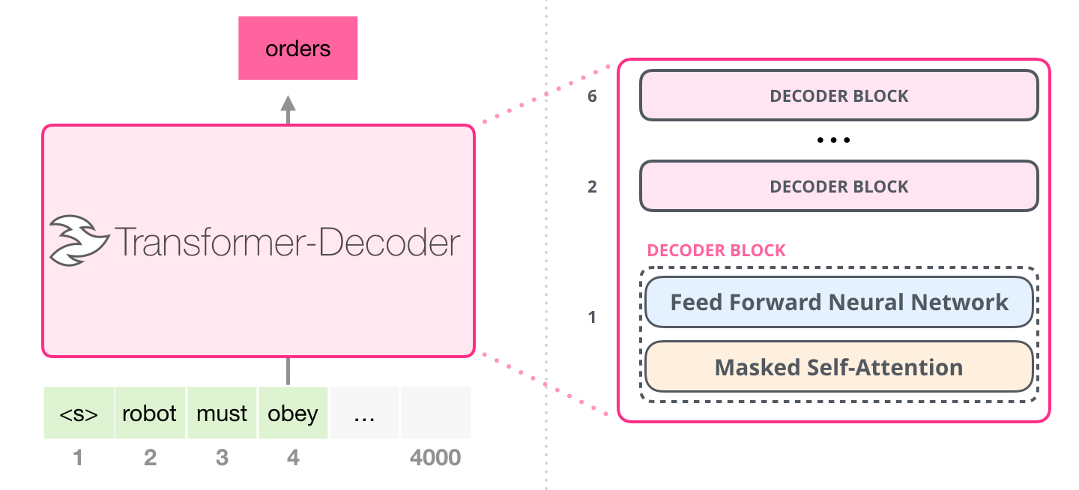
GPT-2
http://jalammar.github.io/illustrated-gpt2/

Slide 70
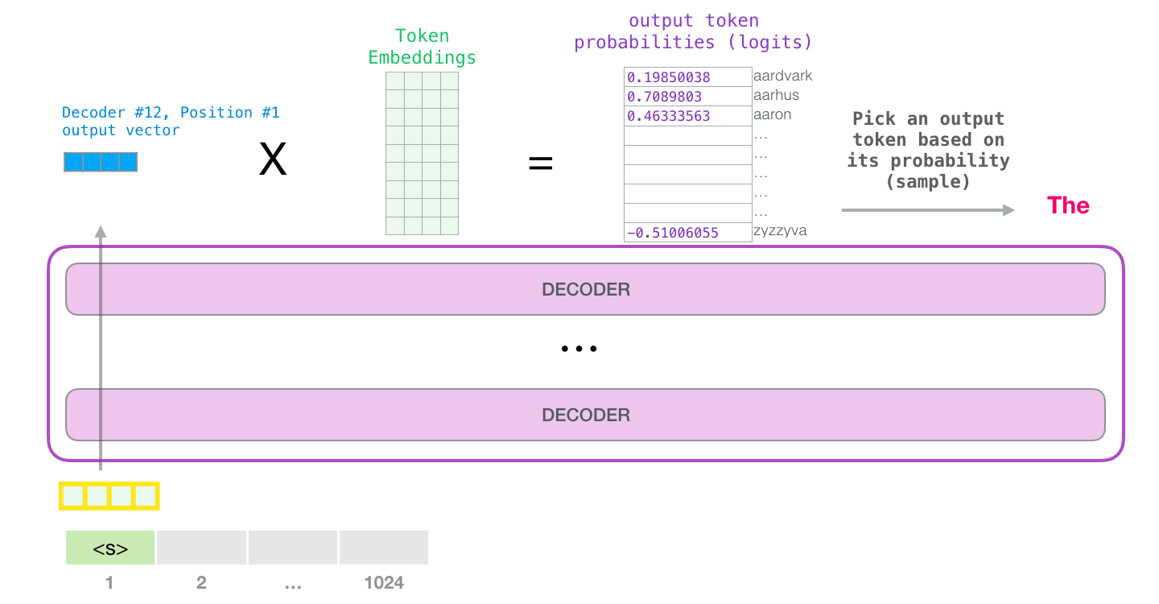
GPT-2
http://jalammar.github.io/illustrated-gpt2/

Slide 71
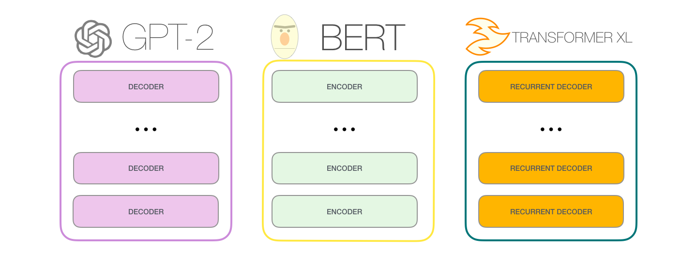
GPT-2 / BERT / Transformer-XL
http://jalammar.github.io/illustrated-gpt2/

Slide 72

Language Model Zoo
ELMo
ULMFiT
GPT
BERT (BioBERT, ClinicalBERT, …)
ERNIE
XLNet
KERMIT
ERNIE 2.0
GPT-2
ALBERT
…

Slide 73
Resources
Open Sourcing BERT: State-of-the-Art Pre-training for Natural Language Processing https://ai.googleblog.com/2018/11/open-sourcing-bert-state-of-art-pre.html
Dissecting BERT Part 1: Understanding the Transformer https://medium.com/@mromerocalvo/dissecting-bert-part1-6dcf5360b07f
Understanding BERT Part 2: BERT Specifics https://medium.com/dissecting-bert/dissecting-bert-part2-335ff2ed9c73
Dissecting BERT Appendix: The Decoder https://medium.com/dissecting-bert/dissecting-bert-appendix-the-decoder-3b86f66b0e5f
The Illustrated BERT, ELMo, and co. (How NLP Cracked Transfer Learning) https://jalammar.github.io/illustrated-bert/
Speeding Up BERT https://blog.inten.to/speeding-up-bert-5528e18bb4ea

Slide 74
Code
TensorFlow code and pre-trained models for BERT https://github.com/google-research/bert
State-of-the-art Natural Language Processing for TensorFlow 2.0 and PyTorch. https://github.com/huggingface/transformers
DeepPavlov: An open source library for deep learning end-to-end dialog systems and chatbots https://github.com/deepmipt/DeepPavlov
Transformers made simple https://github.com/ThilinaRajapakse/simpletransformers https://medium.com/swlh/simple-transformers-multi-class-text-classification-with-bert-roberta-xlnet-xlm-and-8b585000ce3a

Slide 75
Thanks!
grigory.sapunov@ieee.org
gs@inten.to

